Slide 1
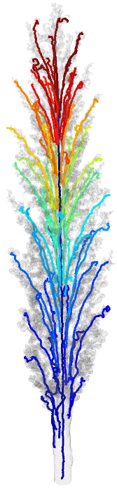
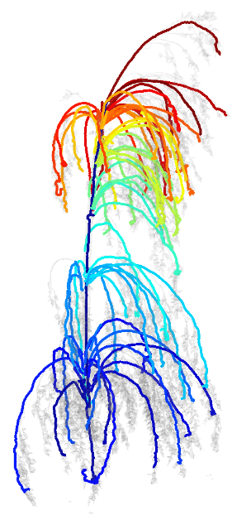
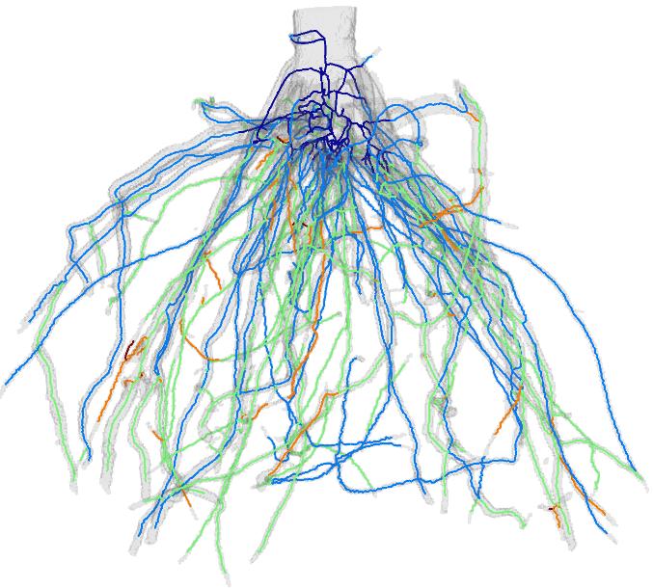
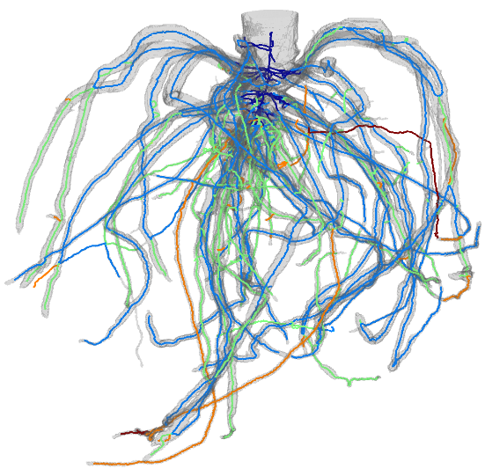
TopoRoot: An automatic pipeline for plant architectural analysis from 3D Imaging
Dan Zeng
Washington University in St. Louis
North American Plant Phenotyping Network Conference 2021
Notes:
Hi everyone, I am Dan Zeng, and I present TopoRoot, an automatic pipeline for plant architectural analysis from 3D imaging.

Slide 2
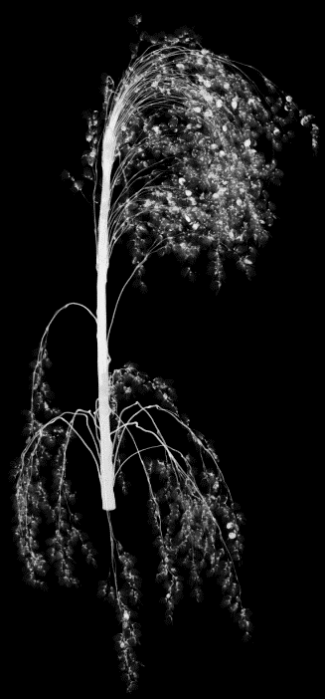
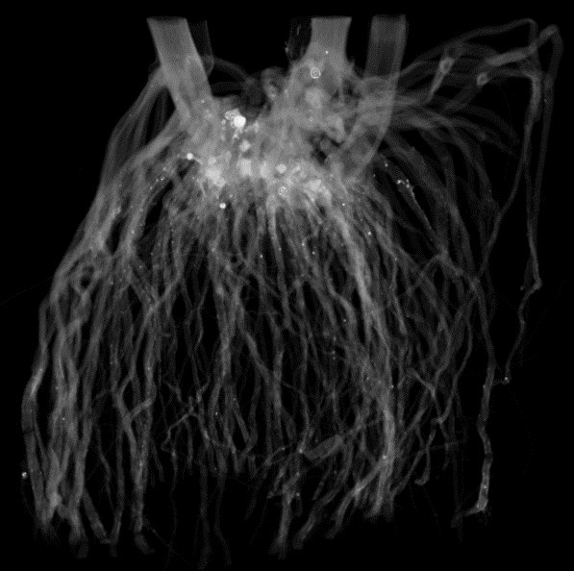
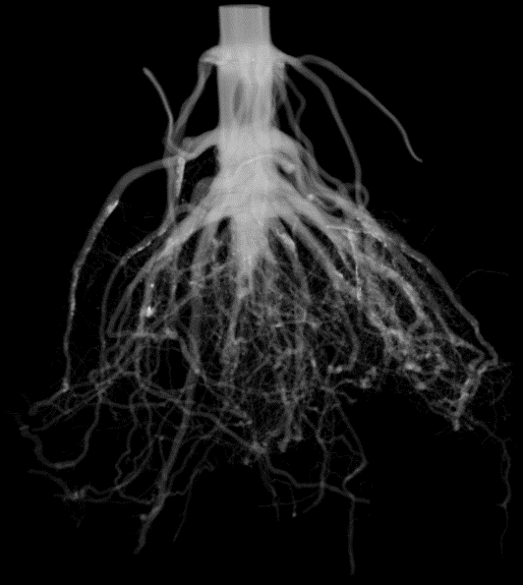
3D Imaging
3D imaging can now capture plant structures above and below the soil with high throughput and accuracy
X-ray CT:
Sorghum Roots
Sorghum Panicles
Maize Root Crowns
Other modalities: Optical, PET, MRI
Notes:
3D imaging can now capture plant structures both above and below the soil with high throughput and accuracy. X-ray CT imaging especially now has the ability to capture very complex structures such as sorghum roots, sorghum panicles, and maize root crowns with high resolution. Other imaging modalities such as Optical imaging, PET, and MRI have also emerged to be able to capture the plant at different granularities and points in time.

Slide 3
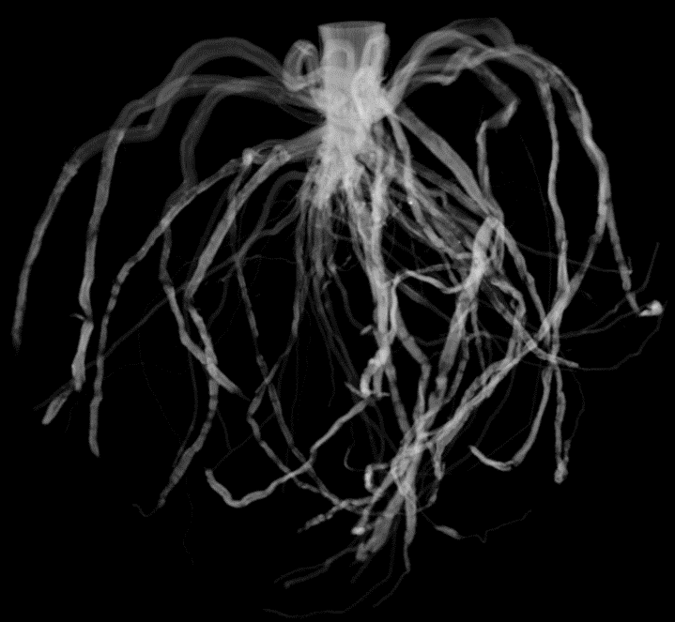
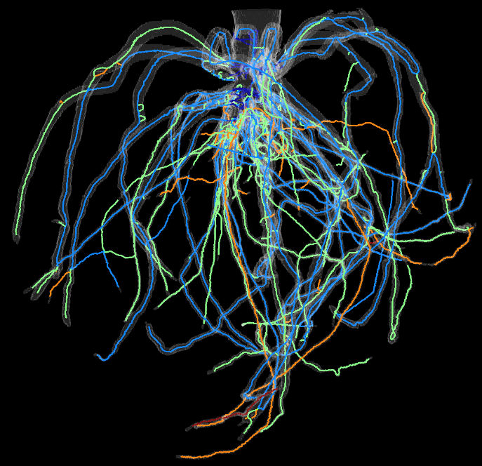
Problem
Obtain fine-grained architectural traits from the imaging for genetic studies
Geometric Traits (e.g. branch lengths, angles, and branch count)
Hierarchy (e.g. stem, primary root, lateral roots)
Needs to have high accuracy and throughput
Grayscale Image
Architecture
Notes:
One of the primary goals for plant phenotyping is to be able to obtain fine-grained architectural traits from the imaging for genetic studies. This includes computing geometric traits such as branch lengths, angles, and count as well as computing the hierarchy, such as the stem, primary root, and lateral roots. In order to be useful for genetic studies, these traits need to be both accurate and computed with high throughput.

Slide 4
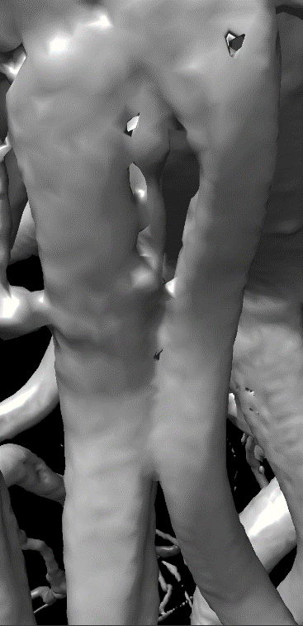
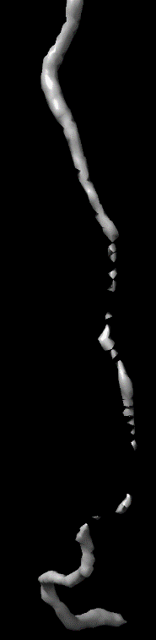
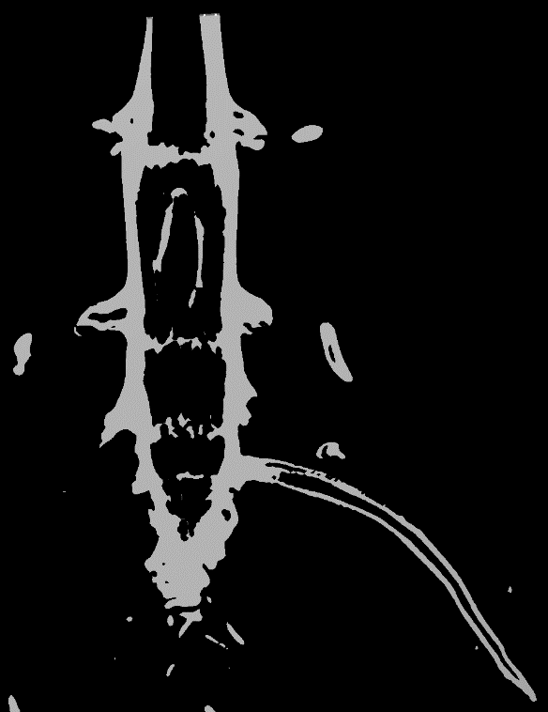
Challenges
Topological and geometrical issues hinder an accurate representation of the architecture
Merged branches
Disconnections
Internal voids
Notes:
A major obstacle to obtaining fine-grained architecture is the presence of topological and geometrical errors in shapes reconstructed from the image volume, which can come in the form of merged branches creating cycles, disconnections between different parts of branches, and internal voids within the stem of the plant and along the branches. Issues such as these make it very challenging to obtain accurate g.ometric and hierarchical traits

Slide 5
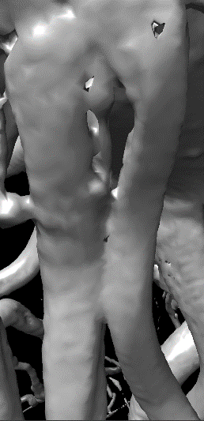
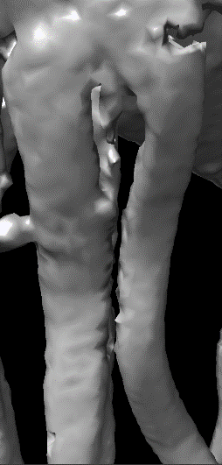
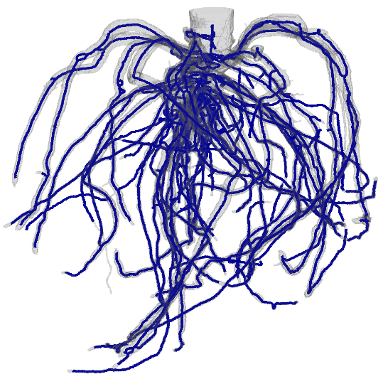
Our Solution: TopoRoot 1.0
An automatic pipeline of geometric algorithms for computing architectural traits from 3D grayscale images
3D Grayscale Image
Topological repair
Skeletonization
Architecture
Notes:
In consideration of these challenges, we present TopoRoot 1.0, a novel automatic pipeline of geometric algorithms for computing architectural traits from 3D grayscale images. Beginning from the image, we first perform topological repair to resolve the mentioned issues, skeletonize the repaired shape, and compute architecture. At each stage, we introduce novel algorithms from the graphics and geometry communities to solve key challenges.

Slide 6
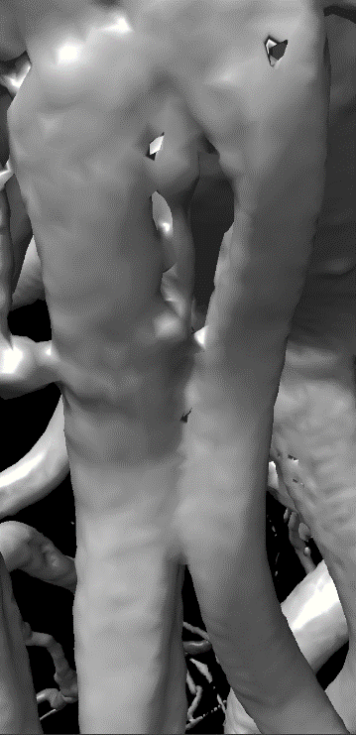
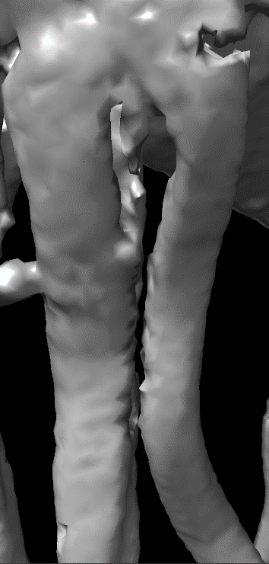
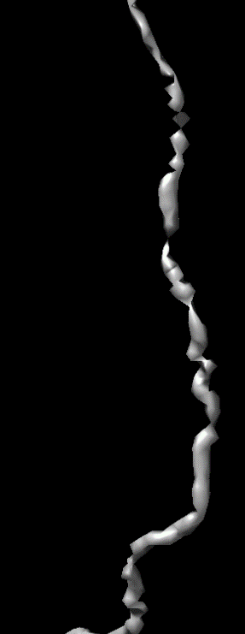
Topological repair
Excessive topological features are removed with minimal geometric change [Zeng et al. 2020]
Some features are cut away, others are filled in depending on which results in a smaller change
Cutting a cycle
Filling to connect components
Notes:
We first perform topological repair on an initial shape reconstructed from the grayscale image. Excessive topological features are maximally removed with minimal geometric change, with some features being cut away, and others being filled in depending on which results in a smaller change.

Slide 7
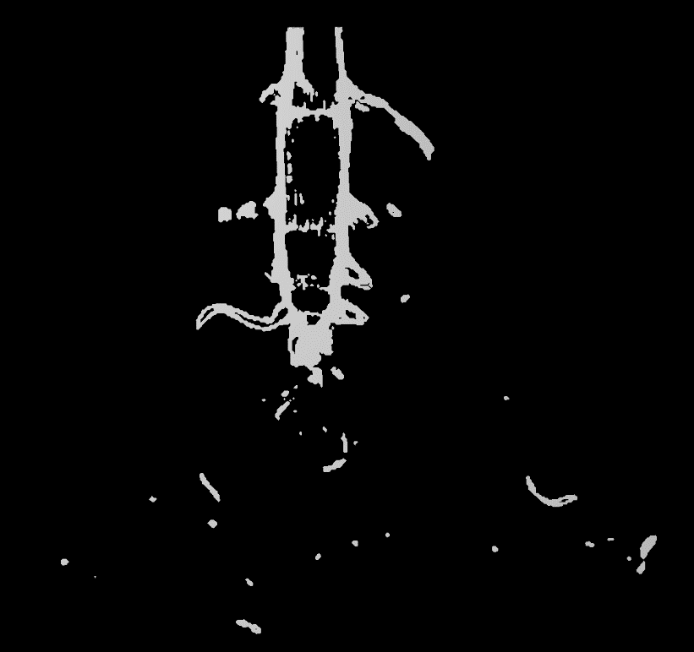

Topological repair
Remaining voids are filled in automatically using ImageJ’s built-in hole filling tool
Cross-sectional view:
Voids prior to hole filling
Stem and roots are filled in

Slide 8
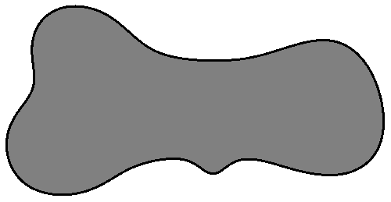
Skeletonization
The shape is thinned to curves known as its medial axis [Yan et al. 2016, 2018]
Nodes and edges make it easier to compute architecture
Geometry is encoded (thickness, width)
Thinning from shape to medial axis
Notes:
The repaired shape is then skeletonized, being thinned to curves known as the shape’s medial axis. The skeleton is represented as nodes and edges, making it easier to compute architecture, and also comes encoded with a set of geometric traits which fully describe the plant’s shape.

Slide 9
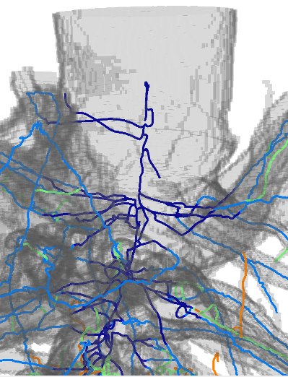
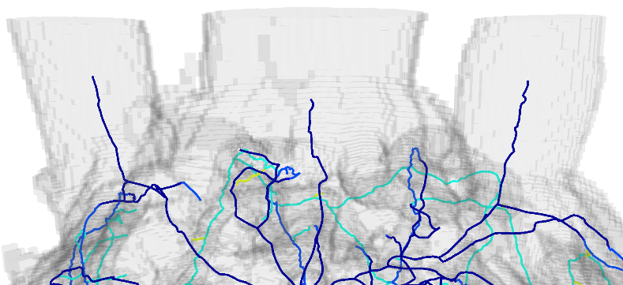
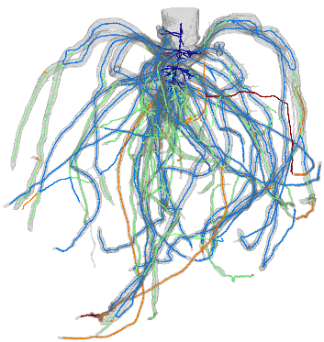
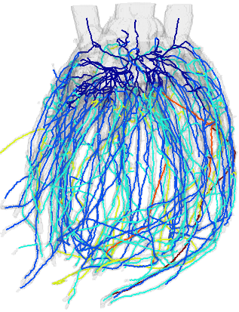
Computing architecture
1. Stem detection algorithm: identify thick portions of the skeleton
Works with single tiller and multiple tiller examples
Sorghum root with one tiller
(dark blue)
Sorghum root with three tillers
Notes:
For computing architecture, we introduce several novel algorithms based on our knowledge about the plant’s geometry and structure. We first offer a new stem detection algorithm which identifies thick portions of the skeleton, and which works for both single tiller and multiple tiller instances.

Slide 10
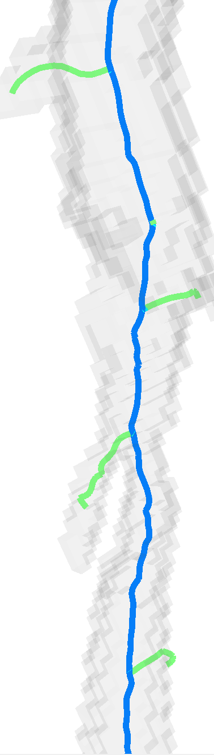

Computing architecture
2. Computing hierarchy: our algorithm minimizes the maximum branching depth
Also considers branch length and angle continuity
The computed lateral root (blue) minimizes branching depth
Notes:
We next compute hierarchy using a novel algorithm which minimizes the maximum branching depth across all branching levels, and which also considers branch length and angle continuity

Slide 11
Computing architecture
3. Geometric traits:
Branch count and number of child branches
Length and tortuosity
Angles (to parent branch, to gravity, emergence, tip, midpoint)
1
2
Thickness
Many more are possible
4
3
Notes:
Based on the computed hierarchy, we can generate several traits, such as those shown here.

Slide 12

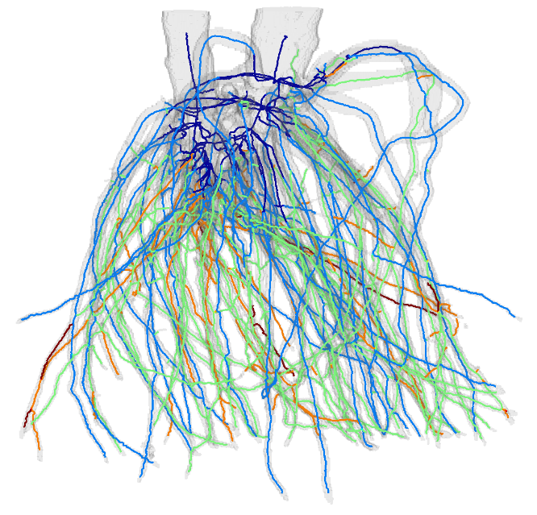
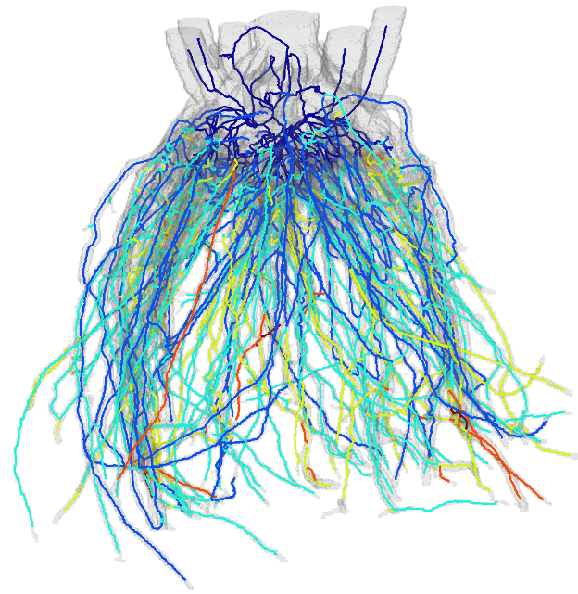
Results
Sorghum Roots
777 roots processed for genetic analysis (~1200 in the end)
Approximately 8 minutes / root without user intervention
To be added: preliminary genetic analysis
Notes:
As part of a large-scale study to discover the genetic bases of Sorghum root and panicle architecture, we first processed 777 roots into our pipeline, with each sample being processed in a matter of minutes without user intervention.

Slide 13
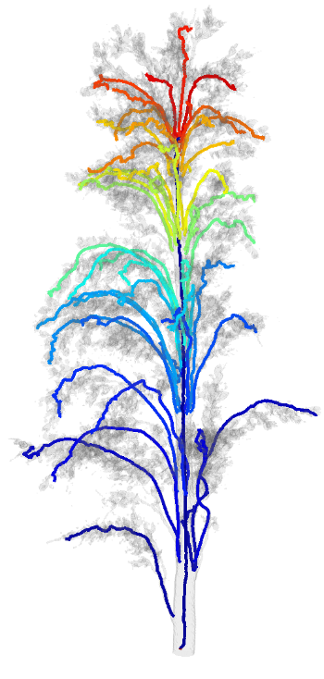
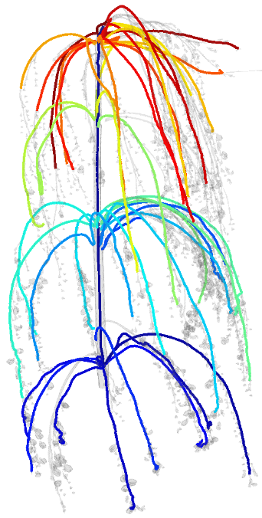
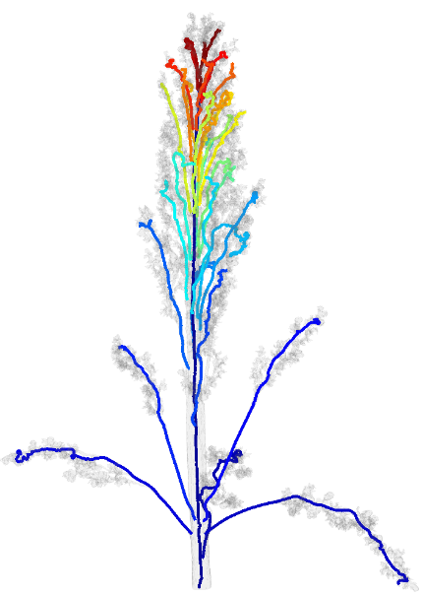
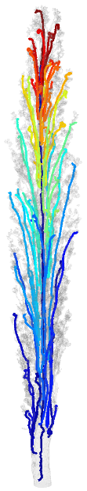
Results
Sorghum Panicles
524 panicles processed for genetic analysis
Primary branch identification swapped in place of hierarchy algorithm
Strong correlation with ground truth measurements
Notes:
As the second half of this study we processed over 500 panicles, and swapped in a state-of-the-art primary branch identification algorithm in place of our hierarchy, demonstrating the flexibility of our pipeline. The computed traits demonstrated a strong correlation with ground truth measurements.

Slide 14
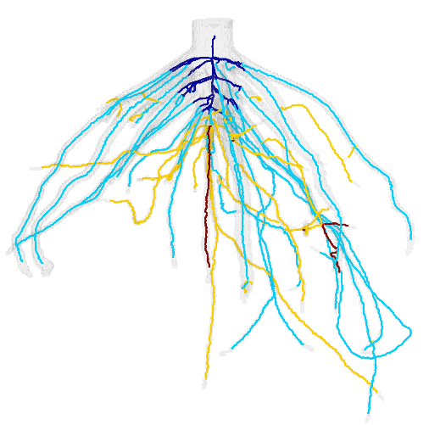
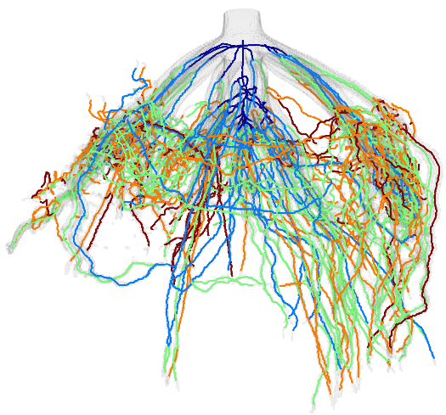
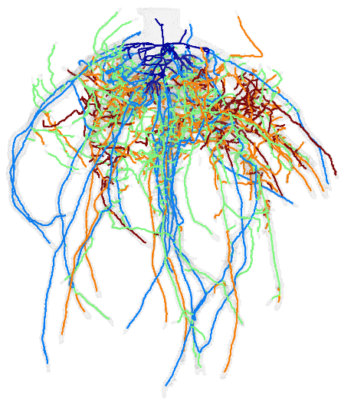
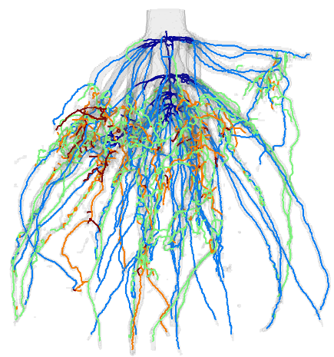
Other applications
TopoRoot may be applied to other plant forms with a branching structure:
Maize root crowns
Soy roots
Time-series data
Additional traits
May improve accuracy of the computed hierarchy
Software on Github: https://github.com/danzeng8/TopoRoot
Installation Instructions
Examples
Maize root architectures
Notes:
In terms of other applications, TopoRoot may also be applied to other plant forms with a branching structure, both above below the soil. Recently we have been exploring computing maize root architectures. Time-series data may also offer additional traits, and improve the accuracy of our computed hierarchy.
Here is a link to download and explore our pipeline on Github, with installation instructions and examples.

Slide 15
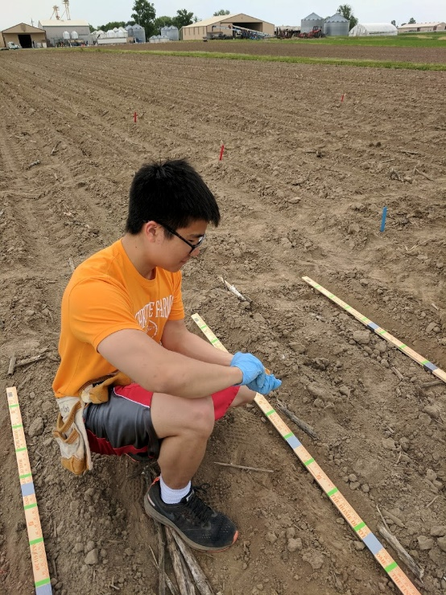
Acknowledgements
Chris Topp
Mon-Ray Shao
Mao Li
Keith Duncan
Ni Jiang
David Letscher
Erin Chambers
Hannah Schreiber
Tao Ju
Yiwen Ju
Yajie Yan
Funding:
This material is based upon work supported by the National Science Foundation under Award number: DBI-1759796 (Collaborative Research: ABI Innovation: Algorithms for recovering root architecture from 3D imaging)
I am funded by the Imaging Sciences Pathway Fellowship from Washington University in St. Louis
Planting sorghum seeds on internship with Chris Topp ‘s lab at DDPSC, May 2018; where the pipeline truly begins!
Notes:
Here are my acknowledgements, thank you for listening.

Slide 16
References
Dan Zeng, Erin Chambers, David Letscher, and Tao Ju. 2020. To cut or to fill: a global optimization approach to topological simplification. ACM Trans. Graph. 39, 6 (2020), 201.
Yajie Yan, David Letscher, and Tao Ju. 2018. Voxel Cores: Efficient, robust, and provably good approximation of 3D medial axes. ACM Trans. Graph. 37, 4 (2018), 44.
Yajie Yan, Kyle Sykes, Erin Chambers, David Letscher, and Tao Ju. 2016. Erosion Thickness on Medial Axes of 3D Shapes. ACM Trans. Graph. 35, 4 (2016), 38.

